Slide 1
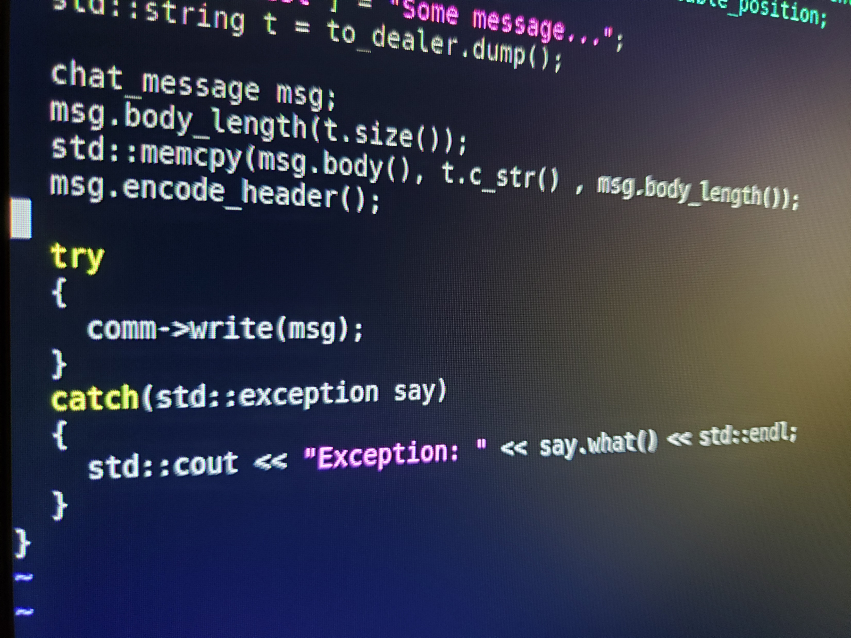
Project Summary Report
Group 002-5
Project Summary Report
Group 002-5

Slide 4
Group Dynamics:
Communication via GroupMe
Communication suffered after COVID-19
Moderate balance of skills
…need more stuff here

